Slide 1
Simple Linear Regression
My First Model

Slide 2

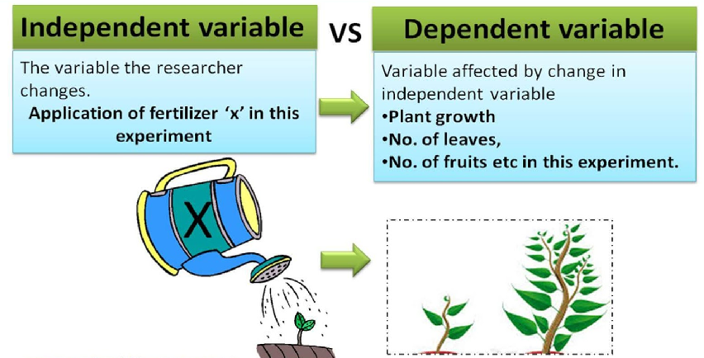
Variable Definition

Slide 3
Variable Definition

Slide 4
Variable Definition

Slide 5
Variable Definition
Data ==== Dataset
I will have :
n Number of Independent Variable
1 Dependent Variable
Independent Variable is presented as X
Dependent Variable is represented as y

Slide 6
How to identify the problem?
Problem Statement.

Slide 7
How to identify the problem?
Problem Statement.
We look at their data and identify the dependent variable on the basis of the problem statement.

Slide 8
How to identify the problem?
Problem Statement.
We look at their data – dependent variable on the basis of the problem statement.
If my dependent variable is a number. -> Regression Problem

Slide 9
How to identify the problem?
Problem Statement.
We look at their data – dependent variable on the basis of the problem statement.
If my dependent variable is a number. -> Regression Problem
If my dependent variable is a categorical value (true/false, Yes/No) -> Classification problem.

Slide 10
Regression Models
Regression models are used for predicting a real value, like salary, price, profit for example.
If the independent variable is time, then forecasting future values, otherwise the model is predicting present but unknown values.
We will learn the following Regression models:
Simple Linear Regression
Multiple Linear Regression
Polynomial Regression
Support Vector for Regression (SVR)
Decision Tree Classification
Random Forest Classification

Slide 11
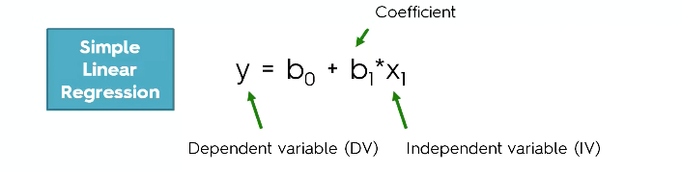
Simple Linear Regression
Linear Equation:

Slide 12
Simple Linear Regression

Slide 13
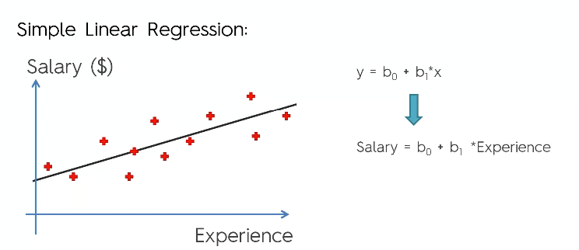
Simple Linear Regression

Slide 14
Simple Linear Regression

Slide 15
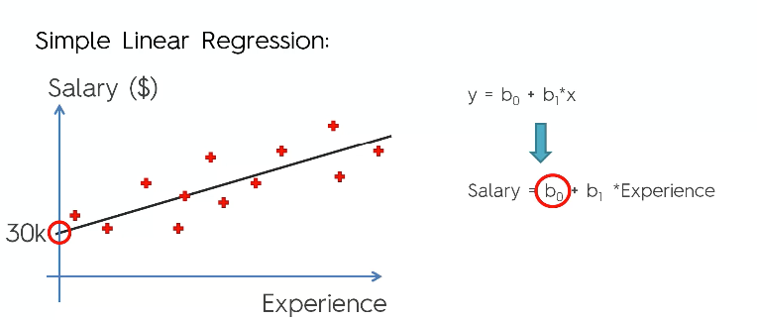
Simple Linear Regression

Slide 16
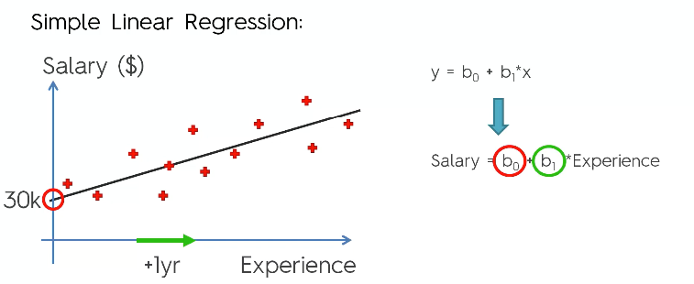
Simple Linear Regression

Slide 17
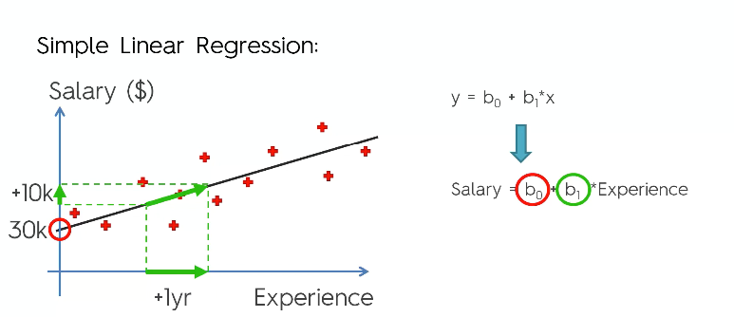
Simple Linear Regression

Slide 18
Simple Linear Regression
How do draw that line in Memory ?

Slide 19
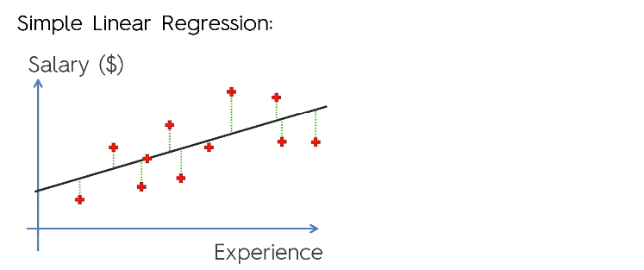
Simple Linear Regression

Slide 20
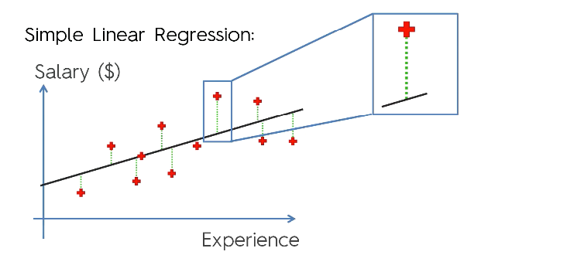
Simple Linear Regression

Slide 21
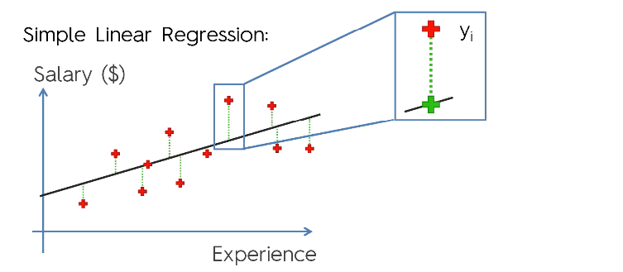
Simple Linear Regression

Slide 22
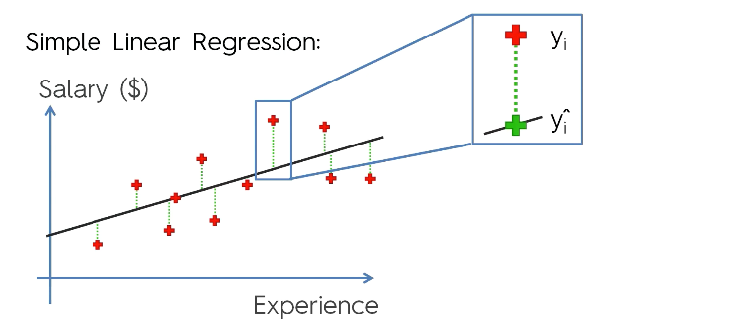
Simple Linear Regression

Slide 23
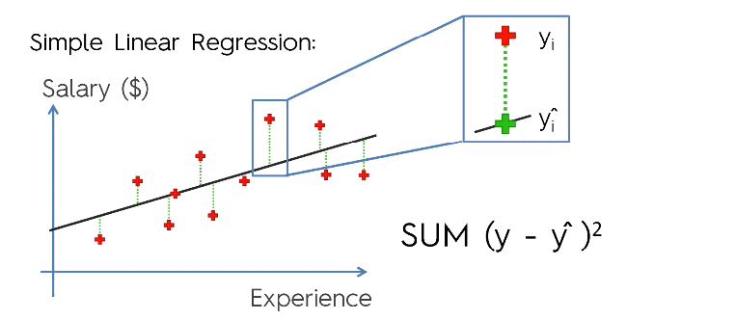
Simple Linear Regression

Slide 24
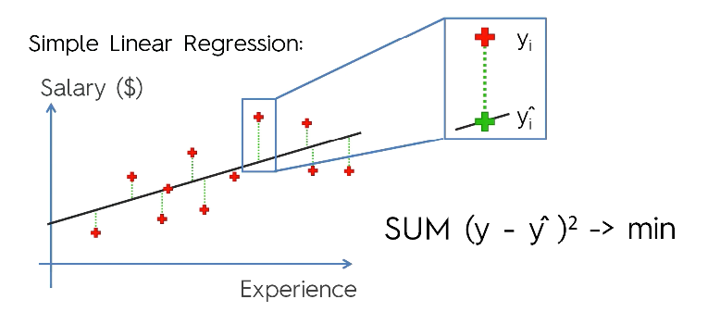
Simple Linear Regression

